Slide 1
YJB Live Presentation
Justin Russell
Her Majesty’s Chief Inspector of Probation
25 November 2020

Slide 2
HMIP current youth inspection priorities
Onsite inspection suspended at end of March and won’t restart until spring 2021.
‘Remote’ inspections restarted at beginning of June. North Yorkshire and Birmingham YOTs; thematic inspection of YOT work during Covid-19 pandemic – June/July.
Remote inspections of 14 ‘small YOTs’ from August to October – results now being published.
Thematic inspections on services for black, Asian and minority ethnic children, and of transition from YOT to probation services to start in early 2021.
New standards for resettlement from custody work and OOCD policy and practice to be introduced in spring 2021.

Slide 3
Impact of Covid-19 on youth offending services
We looked at work of seven different YOTs between March and June; analysed 70 higher risk cases and 220 responses to our staff survey. We found:
Rapid and effective switch to remote supervision of caseload and ‘virtual’ multi-agency working– using a range of digital platforms.
Major impact on courts and on custodial population. Court backlog increased 50%; youth custody population fell 27% by June 2020 compared to 2019.
No single exceptional delivery model – depended on each local authority’s Covid-19 response. Less staff sickness or deployment than anticipated.
Referral order, out of court and risk panels all moved online and worked reasonably well.
Face to face contact with highest risk / most vulnerable children maintained – innovative methods for keeping in touch – ‘walk and talk’; bike rides; allotments.
Focus on basic welfare needs (e.g. help with food parcels) and risk management – but some interventions still delivered and innovation around ‘reparation at home’. Parents more involved in delivery during lockdown.

Slide 4
Delivery during first Covid lockdown - strengths
Great commitment by staff and managers to keep services going – prioritising children in greatest need and workforce safety.
Good staff support – 86% of staff told us they’d had ‘excellent’ or ‘good’ support form their organisation (though additional pressures on line managers). 97% said their caseloads were manageable.
Good partnership working with police and social services – easier to attend case conferences online than pre-Covid-19 face to face meetings. (87% of staff said they had sufficient access to services, interventions and partnership resources for their caseloads).
IT technology was generally available to staff (laptops and smartphones) though local security rules prevented some functionality. Three quarters of staff said they’d had to use new tech during lockdown.

Slide 5
Delivery during first Covid lockdown – areas of concern
Digital divide – almost half of children whose cases we inspected didn’t have the internet enabled technology they needed to access school lessons or resources from YOTs.
Very poor education provision. Very few children attended school, including those meeting ‘vulnerable’ classification and poor home learning as well. 40 per cent of our sample didn’t access any form of education or training during lockdown.
Difficulties in contacting children in custody made resettlement planning difficult. No face to face visits and very limited online contact.
Child violence towards parents/carers an increasing concern during lockdown period – and lack of provision for parental victims highlighted.
Increasing court backlogs leading to increased delays in cases coming to court and time held on remand and in processing of breaches.
Out of area placements during lockdown – case responsibility could and should have remained with ‘home’ YOT if supervision is being undertaken remotely.

Slide 6
16 YOT inspections in our 2019/2020 programme
1 Leeds | 9 Luton
2 Croydon (joint) | 10 Camden
3 Leicester City | 11 Oxfordshire
4 Brent | 12 Cardiff (joint)
5 Southampton | 13 Medway
6 Bradford (joint) | 14 Bury & Rochdale
7 Gloucestershire | 15 North Yorkshire
8 Nottingham City (joint) | 16 Birmingham
15
6
1
14
8
3
16
9
4
12
11
10
2
13
7
5

Slide 7
CURRENT YOUTH JUSTICE INSPECTION FRAMEWORK
Organisational delivery
1.1 Governance and leadership
Court disposals
2.1 Assessment
2.2 Planning
Out of court disposals
3.1 Assessment
1.2 Staff
1.3 Partnerships and services
1.4 Information and facilities
2.3 Implementation and delivery
2.4 Reviewing
3.2 Planning
3.3 Implementation and delivery
3.4 Joint working

Slide 8
Overall ratings have worsened in 2019/2020

Slide 9
Organisational delivery
Two thirds of YOTs rated as ‘Good’ or ‘Outstanding’ on staffing with committed and well trained staff and manageable caseloads.
Four YOTs rated ‘outstanding’ on the range and quality of services they offered children on their caseloads.
But
Ten out of 16 YOTs inspected in 2019/2020 rated ‘Requires improvement’ or ‘Inadequate’ on governance and leadership.
YOTs scoring inadequate on leadership had often had multiple changes of head of service or insufficient capacity in the senior leadership team.
Management oversight of cases was sufficient in only just over half of inspected cases – compared to two-thirds in 2018/2019.

Slide 10
Youth justice management boards

Slide 11
No correlation between funding and inspection scores

Slide 12
Key questions on case supervision quality
Does the YOT support the child or young person’s desistance?
Does the YOT keep the child or young person safe?
Does the YOT keep other people safe?

Slide 13
Quality of case supervision – key themes
Volume of court ordered cases continues to fall – down almost 80% from 2009 to 2019.
Increase in proportion of violent offences and cases assessed as presenting high safety and wellbeing concerns.
Increased delays in cases coming to court – made worse by Covid-19.
Three YOTs scored inadequate or requires improvement across all supervision standards for court cases and three scored good or outstanding across all standards.
Out of court cases are an increasing proportion of YOT caseloads – particularly community resolutions.
Average inspection scores for out-of-court cases were lower than for court-ordered ones – though four YOTs scored ‘Good’ or ‘Outstanding’ on all out of court supervision standards.
Work to manage risk of harm was done much less well in out of court cases. Assessment and planning for risk of harm was judged to be ‘Inadequate’ in seven out of 16 YOTs.

Slide 14
Quality of case work around desistance is higher than for safety of child or risks of harm to others
(Percentage of court order cases rated as satisfactory on each standard – 2019/2020 inspections)

Slide 15
Supervision of community resolution cases continues to score lower than YCs and YCCs

Slide 16
Looked after children are receiving poorer supervision than others
 | Assessment | Planning | Delivery | Reviewing
Children not in care | Good | Good | Good | Good
Children in care living inside the inspected area | Good | Requires improvement | Good | Requires improvement
Children in care living outside the inspected area | Good | Requires improvement | Requires improvement | Requires improvement

Slide 17
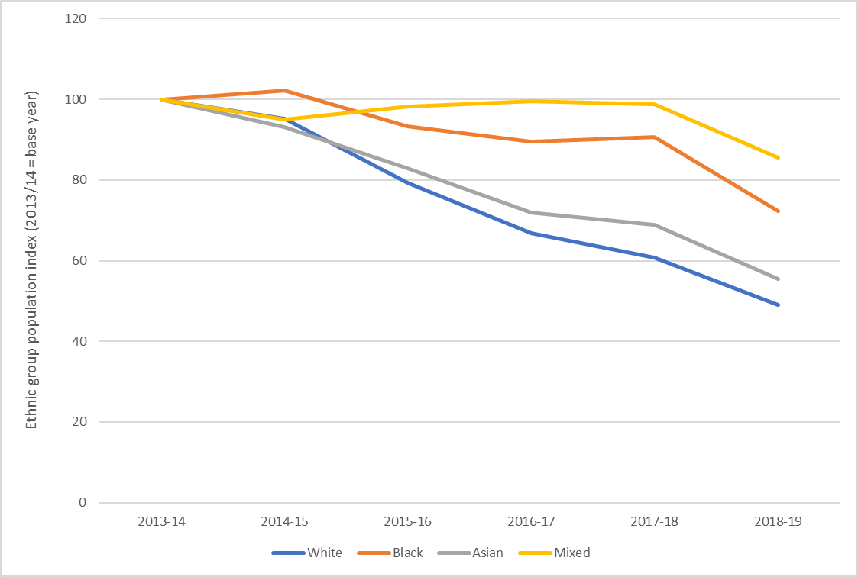
Change in relative number of children on YOT caseloads 2013 to 2019 - by ethnicity
Ethnic group population index (2013/14 = base year)

Slide 18
Quality of court case supervision in 2019/2020 by ethnicity
 | Assessment | Planning | Implementation and delivery | Reviewing
White children | Good | Requires improvement | Good | Requires improvement
Black children | Good | Requires improvement | Good | Good
Asian children | Requires improvement | Good | Good | Good
Mixed heritage children | Good | Requires improvement | Good | Inadequate
Other | Requires improvement | Inadequate | Requires improvement | Inadequate
Good = > 65% of cases; Requires Improvement = 50 – 65%; Inadequate = < 50% of cases
(N = 462 cases)

Slide 19
Some further reading
Further details of our inspection rating scores over the past year can be found at:
https://www.justiceinspectorates.gov.uk/hmiprobation/about-our-work/our
standards-and-ratings/ratings-tables/
Our report on the impact of Covid-19 on youth offending services during the first lockdown from March to June 2020 can be found at:
https://www.justiceinspectorates.gov.uk/hmiprobation/inspections/edmyouth/
Our annual report on YOT inspection reports published between November 2019 and
October 2020 can be found at:
https://www.justiceinspectorates.gov.uk/hmiprobation/inspections/yar2020/
You can also follow us on Twitter @HMIProbation or read more on our webite:https://www.justiceinspectorates.gov.uk/hmiprobation/

